Slide 1
MS 70-480
HTML, CSS & JavaScript
John Lokerse & Mitchel Hulst

Slide 2
Inleiding
HTML5
JavaScript
JavaScript Program Flow
JavaScript Events
CSS deel 1
Pauze
CSS deel 2
Advanced JavaScript (indien tijd over)

Slide 3
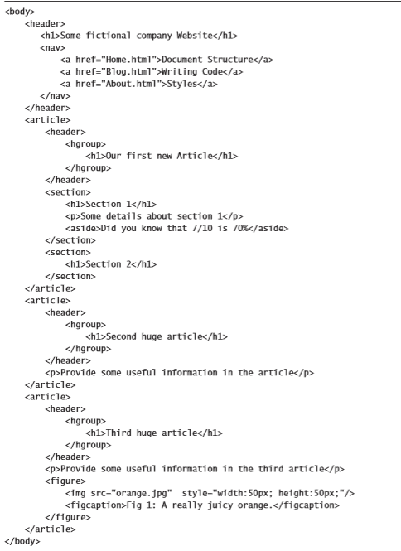
HTML5 the basics
Document structuur
SEO optimalisatie
Screen readers
Header grouping
Article = volledige compositie
Section = opsplitsen van de pagina en/of een article
Aside = content buiten de main flow
Figure = een foto met onderschrift
Progress bar
Tekst markering
Media elementen

Slide 4
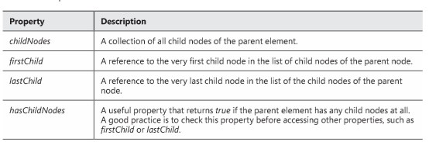
JavaScript DOM manipulatie
getElementById() / getElementByClassName() / getElementsByTagName()
querySelector()/ querySelectorAll()
Let goed op de parameter
Verwijder elementen van de DOM
CSS toevoegen met JavaScript
Transform: skew, scale, translate, rotate
Tonen en verbergen van elementen

Slide 5
Canvas
Kan je gebruiken om te tekenen op een webpagina met JavaScript.
2 assen (X en Y)
0
X as
0
Y as

Slide 6
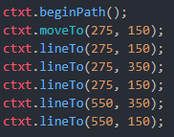
Tekenen op het canvas
Selecteer het canvas via getElementById.
Haal de 2D context.
Nu heb je de referentie naar het canvas.
beginPath();
moveTo(x, y);
lineTo(x, y);

Slide 7
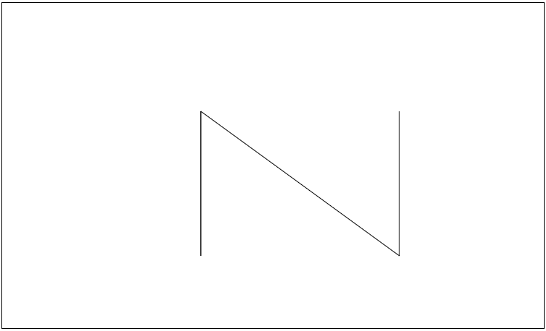

Slide 8


SVG
Scalable Vector Graphics
Schaalbaarder dan canvas
Performance kan een probleem worden ivm hoge resolutie
XML-based
Built-in:
Polygon
Polyline
Line
Ellipse
Text
Circle

Slide 9
HTML5 API's
Sinds HTML5 zijn er ingebouwde API's
Storage API
Local storage en session storage
AppCache manifest (DEPRECATED)
Geolocation API
Window.navigator.geolocation
GetCurrentPosition() (eenmalig opvragen)
WatchPosition() (continue polling)

Slide 10
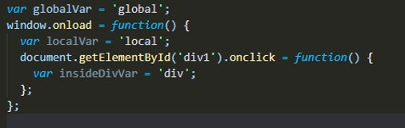
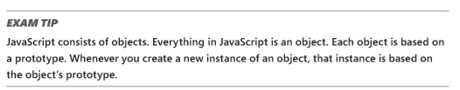
JavaScript Object scopes & prototypes
Variabele Scopes
Object creation
Prototyping
Notes:
However, if you plan to use an object often, consider creating a prototype for it so that you can construct one whenever you need it. A prototype provides a definition of the object so that you can construct the object using the new keyword.

Slide 11
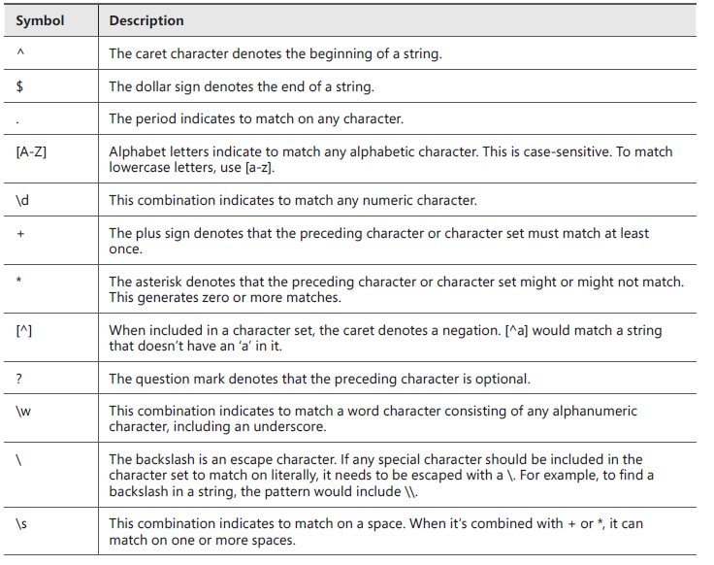
Regular Expressions

Slide 12
Regular Expressions voorbeelden
^[0-9]{4}[\s{1}]?[a-zA-Z]{2}$ of ^\d{4}[\s{1}?][a-zA-Z]{2}$
^[\w-]{7,}$
<input type="text" pattern="^[A-Za-z0-9._%+-]+@[A-Za-z0-9.-]+\.[a-z]{2,4}$">
https://regexr.com/
Notes:
> Postal code (NL)
> Het woord delta-n
> Emailadres

Slide 13
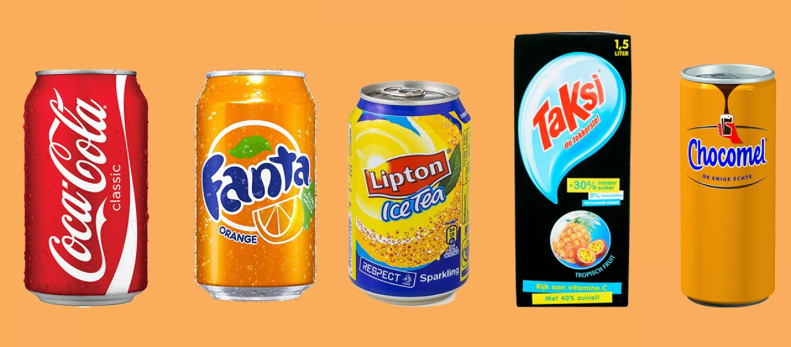
PAUZE

Slide 14
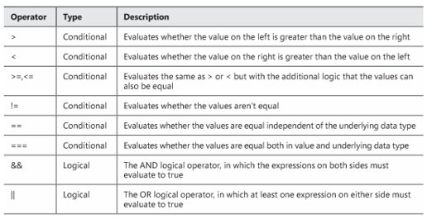
JavaScript Program Flow
Conditions
If / switch
Ternary operator
Arrays
Split, splice, shift & unshift
Notes:
Ternary = condition ? Expression true : false

Slide 15
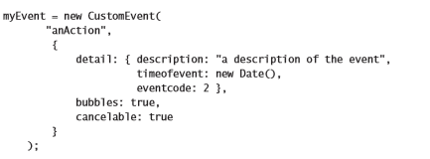

JavaScript Events
Default events
Adding events
Removing events
Event bubbling
Custom events
Focus events
Keyboard events
Mouse events

Slide 16
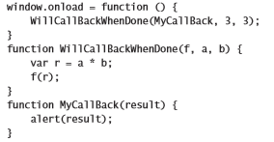
JavaScript Callbacks

Slide 17
Cascading Style Sheets (CSS)

Slide 18
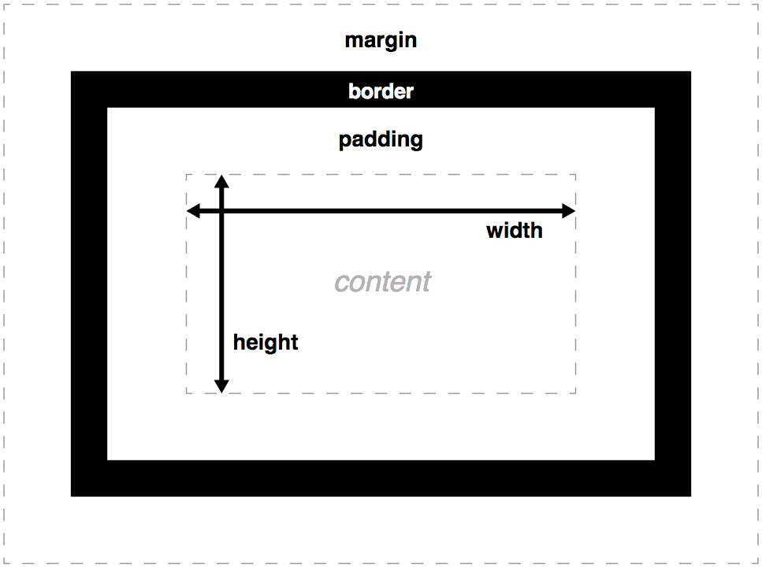
Box Model

Slide 19
Positioning
Verschillende positions:
Absolute
Fixed
Static (default)
Sticky
Relative
Normal flow
Fixed
Static
Relative
Sticky (offset relatief aan nearest scrolling ancestor)
Out-of-Normal flow
Absolute

Slide 20
Position absolute
Gepositioneerd op basis van de browser OF relatief aan de parent.

Slide 21



CSS Selectors
Element selector
Class selector
Attribute selector

Slide 22
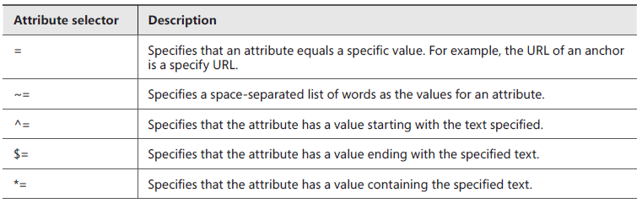
Attribute Selector RegEx

Slide 23
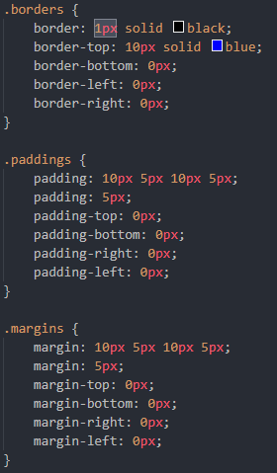
HTML Box Styling
Size
Borders
Let op de shortshands!
Paddings
Let op de shortshands!
Margins
Let op de shorthands!

Slide 24
CSS Altering Graphics Effects
Transparency/Opacity
Gradients
Background image
Gradients
Shadows
Clipping
Werkt alleen bij images die position absolute of fixed hebben.
Deprecated.. Gebruik clip-rect.
Text-shadow

Slide 25
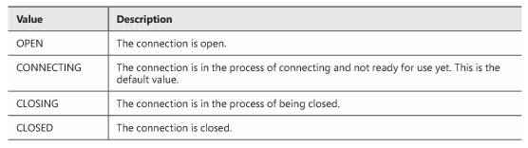
Advanced JavaScript
Ajax
JQuery
Consume XML and JSON
Serialize, deserialize
WebWorker
WebSocket

Slide 26
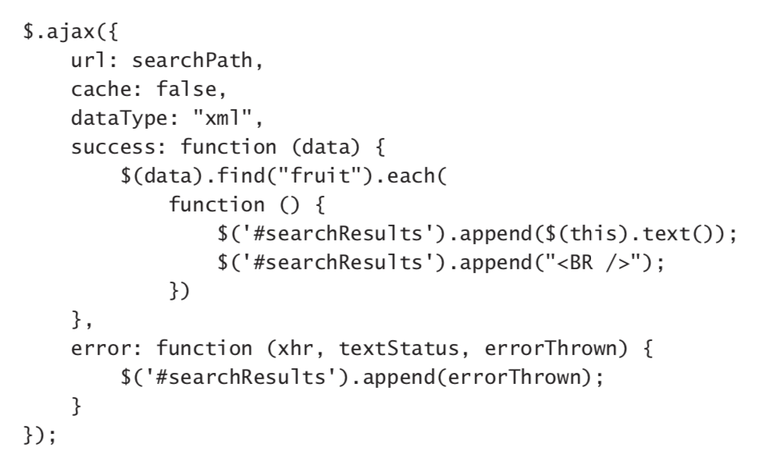
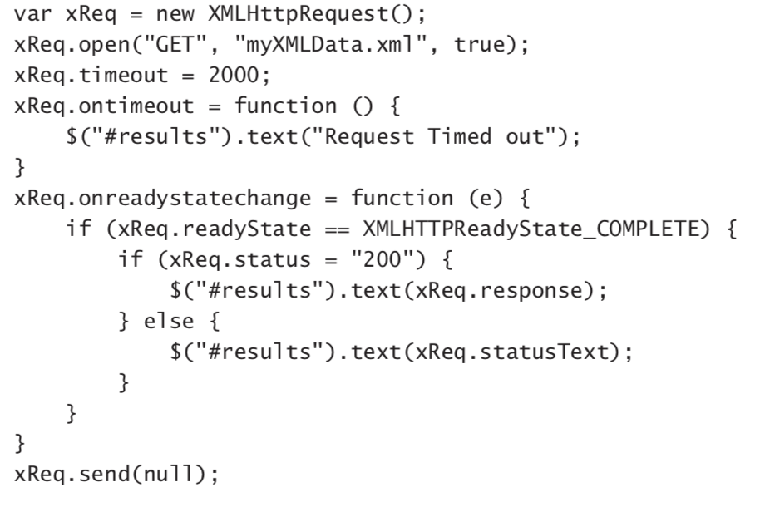
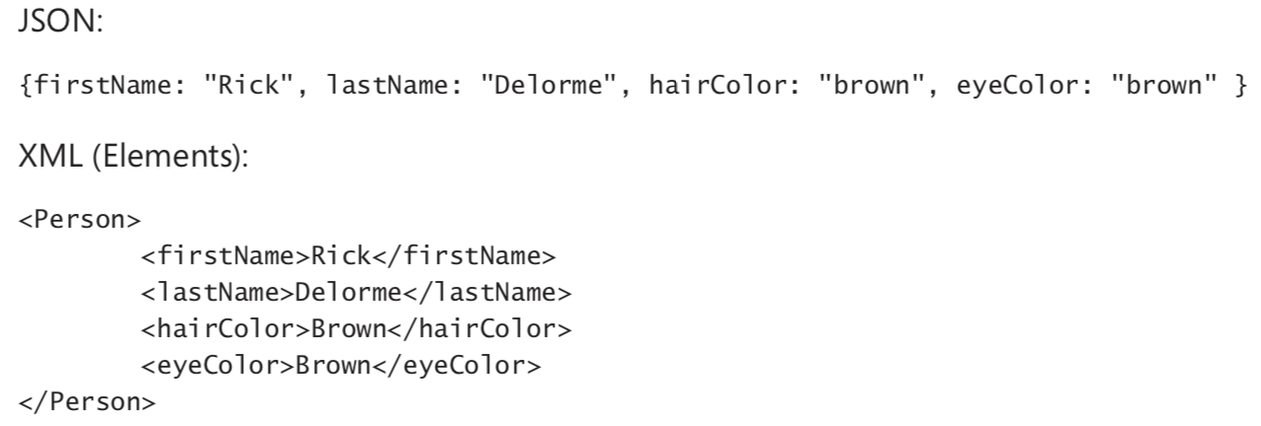
Http requests met JQuery, JSON en XML
Verschillen tussen XML en JSON
XMLHttpRequest
UI block
Http requests versimpelt met JQuery

Slide 27
WebWorker
Uitvoeren van taken op hun eigen thread
Aanmaken webworker
Webworker aanmaken
Uitvoerende javascript meegeven
PostMessage
Teruggeven van berichten -> postMessage -> self
Afvangen van berichten -> onMessage
Terminate vs Close
Geen DOM toegang
Subworkers
Notes:
serializable object such as native data types, JSON
If you want a high volume of workers, consider
creating a pool that can be used in a round-robin fashion so that not too many workers are created.
objects, or XML.
Following the same patterns as for a worker from the main webpage, a worker can create workers as well. All constructs must be followed for passing data and getting data returned. However, knowing how many total workers will be created becomes increasingly important.

Slide 28
WebSocket
Webserver vereist
Real-time applicaties -> chat
Opzetten van een WebSocket verbinding
Aanmaken websocket object
URL -> ws / wss
Subprotocols
Aanhaken op events
Voorbeeld : https://www.websocket.org/echo.html
Notes:
The full implementation of a WebSocket API requires that a webserver have a proper server-side implementation that can accept socket connections. Technologies such as Node.js work well for this purpose. Implementation of such technologies is beyond the scope of this book, and these code samples assume such an implementation exists.
if (wsConnection.readyState == WebSocket.OPEN) {

Slide 29
Voorbereiden op het examen

